Slide 1
SQL Intro

Slide 2
What is Database?
A database is simply a structured collection of data:
your list of songs
your photo gallery
your shopping cart
Data relates to each other by nature, so we use the term Relational Database

Slide 3
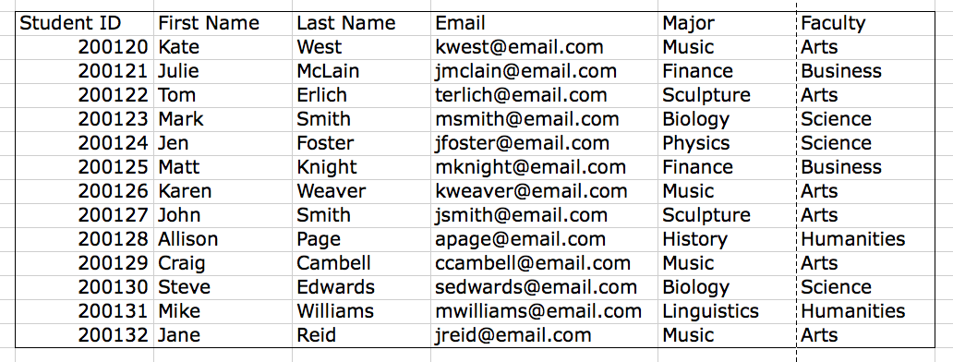
What is Database? (Continued)
A table contains columns and rows, like a spreadsheet.

Slide 4
What is Database? (Continued)
A table may relate to another table:
one-to-one
one-to-many
many-to-one
many-to-many

Slide 5
What is SQL?
SQL stands for Structured Query Language
SQL is the standardized language used to access database
SQL contains three parts:
Data definition language
define the database and its objects, e.g. tables, views, triggers, stored procedures and etc.
Data manipulation language
query and update data
Data control language
grant the permissions to a user to access a certain data in database

Slide 6
What is MySQL?
MySQL is a database management system that allows you to manage relational databases.
It is open source software provided by Oracle.
MySQL is pretty easy to master comparing with other database software like Oracle Database or Microsoft SQL Server.

